Slide 1

Technical presentation
DEEPFAKE DETECTION
CSA1710 – Artificial Intelligence
Guided By:
Dr. NAGARAJAN B
Presented By:
POOJASREE B (192411091)

Slide 2
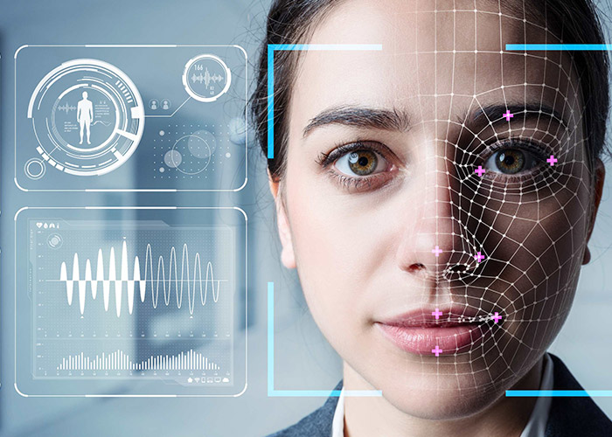
What Are Deepfakes?
Deepfakes are AI-generated or manipulated images, videos, or audio that make a person appear to say or do something they never actually did. Built on deep learning and generative AI, they blur the line between real and synthetic media.
GANs
Autoencoders
Generative Adversarial Networks pit two models against each other to produce photorealistic content.
Compress and reconstruct facial data to swap identities while preserving expressions.
Diffusion Models
Iteratively refine noise into high-fidelity synthetic media with remarkable realism.

Slide 3
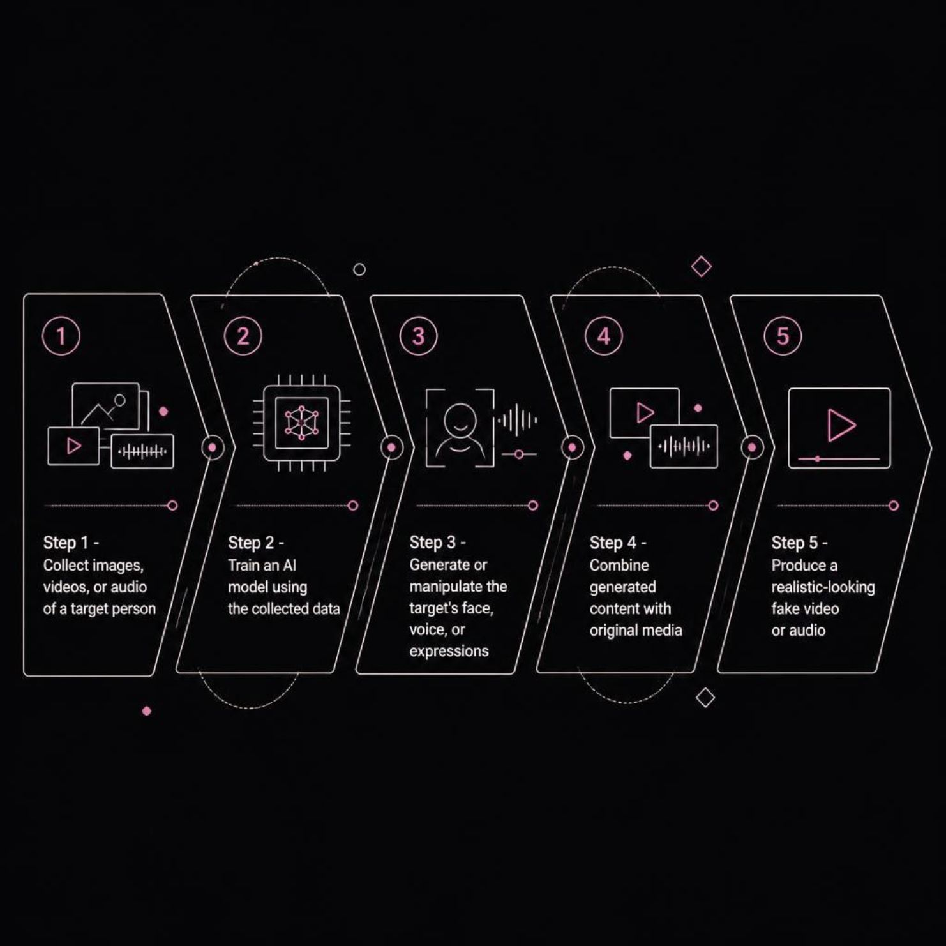

How Deepfakes Are Created
The Face-Swap Example
A person's face can be digitally replaced with another's while preserving facial expressions and movements frame-by-frame. The AI learns the target's geometry, texture, and lighting — then maps a new identity onto the original footage seamlessly.
The quality of the output depends directly on the quantity and diversity of training data collected.

Slide 4
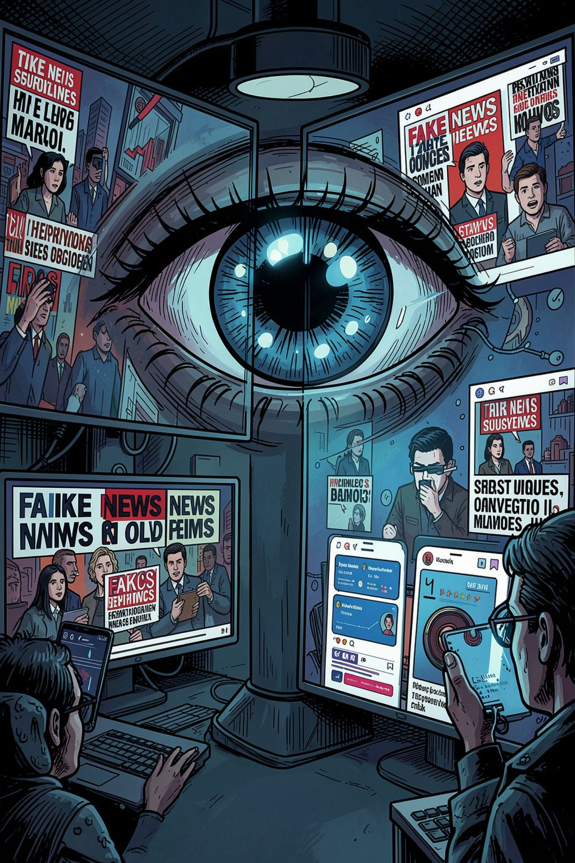




Why Detection Matters
Deepfakes are not just a technical curiosity — they are a real-world threat to individuals, institutions, and democracy itself.
Fake News & Misinformation
Realistic videos can spread false narratives at scale, eroding public trust.
Identity Theft & Fraud
Impersonation of faces and voices enables financial fraud and social engineering.
Reputation Damage
Fabricated content can destroy careers, relationships, and organizational credibility.
Election Manipulation
Synthetic media can be weaponized to influence public opinion and destabilize democracies.

Slide 5
Deepfake Detection Techniques
Detection systems analyze multiple layers of evidence to distinguish real from synthetic media.
1
Visual Analysis
Detects unnatural facial movements, skin texture anomalies, and boundary inconsistencies.
2
Audio Analysis
Identifies unnatural speech patterns, pitch inconsistencies, and synthetic voice artifacts.
3
Temporal Analysis
Compares consecutive frames to catch unusual transitions and inconsistent motion.
4
Metadata Analysis
Examines file creation details, editing history, and encoding signatures.
5
AI-Based Detection
CNNs, RNNs, and Vision Transformers classify media with high accuracy.

Slide 6



Deep Learning Detection Pipeline
Frame Extraction
Face Detection
Feature Extraction
AI Classification
Input
Model Architecture
Sample Output
CNN
RNN / LSTM
The system produces a confidence score for each piece of media:
Extracts spatial visual features from individual video frames.
Analyzes temporal patterns and inconsistencies across frames.
Real: 12%
Deepfake: 88%
Vision Transformer
Ensemble Models
Higher confidence scores indicate stronger evidence of manipulation — but no single threshold is universal.
Learns long-range relationships between image regions for finer detection.
Combine multiple architectures to maximize detection accuracy.

Slide 7


Challenges & Future Scope
Current Challenges
Future Directions
Deepfakes are becoming increasingly photorealistic, narrowing detectable artifacts.
Real-time detection integrated directly into social media platforms.
New generation methods can bypass older detection techniques.
Multimodal systems combining video, audio, and text analysis.
Models may fail on unseen deepfake types not represented in training data.
Robust Transformer models trained on diverse, evolving datasets.
High-quality detection requires large, diverse datasets and significant compute.
Digital watermarking and content provenance standards.

Slide 8
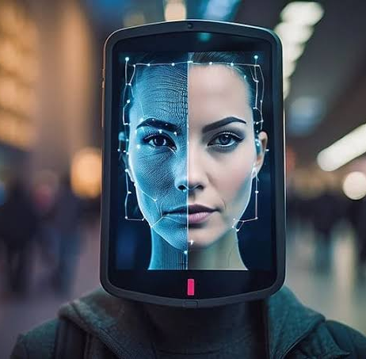
Conclusion
1
Deepfakes are a defining challenge of the Generative AI era
Synthetic media can now replicate faces, voices, and behaviors with near-perfect realism.
2
ML and Deep Learning are our best defense
CNNs, Transformers, and ensemble models provide powerful tools for detecting manipulation.
3
No single technique is sufficient
Combining visual, audio, temporal, and metadata signals improves reliability and robustness.
4
Research must keep pace with generation technology
As deepfake methods evolve, detection systems must continuously adapt and improve.

Slide 9
Thank you..!!

